Slide 1
Algorithms and Data Structures Module 1 Lecture 4 Graph traversals: depth-first search, breadth-first search and their applications. Part 1
Adigeev Mikhail Georgievich
mgadigeev@sfedu.ru
adimg@yandex.ru

Slide 2
Graph traversals
Graph G=(V,E).
A graph traversal: start at a certain vertex and visit other vertices of G in a specific order.
Traversals let us explore the graph and discover its structure.
Depth-first traversal (DFS)
Breadth-first traversal (BFS)

Slide 3
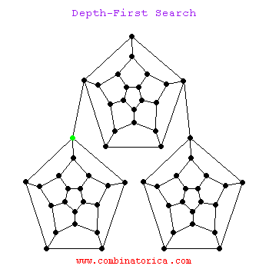
Graph traversals
https://www3.cs.stonybrook.edu/~skiena/combinatorica/animations/search.html

Slide 4
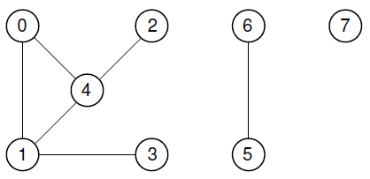
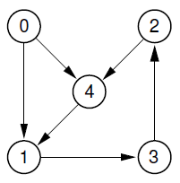
Graph connectivity
Graph G=(V,E).
A path (walk) is a sequence of edges $\left\{e_{1},e_{2},…,e_{l}\right\}$ such that for each $i$the end-point vertex of $e_{i}$ is a start-point of $e_{i+1}$.
Alternative representation: a sequence of vertices $\left\{v_{1},v_{2},…,v_{l+1}\right\}$.
The number of edges = length of the path.

Slide 5
Graph connectivity
A path $\left\{v_{1},v_{2},…,v_{l+1}\right\}$is a cycle iff $v_{1}=v_{i+1}.$
A vertex $v$ is reachable from the vertex $u$ on G iff there is a path on G from $u$ to $v$ .

Slide 6
Graph connectivity
A graph is called connected iff for each pair of vertices$\{u,v\}$ there is a path between $u$ and $v$.
The maximally connected subgraphs of G are called connected components.

Slide 7
Graph connectivity
Problem
Given a graph $G(V,E)$, detect all its connected components.
$\{0, 1,2,3,4\}$
{5,6}
{7}

Slide 8
Graph connectivity
Solution
Mark all vertices as ‘unvisited’.
While there is an unvisited vertex s:
Initialize a new component $C_{k}$.
Start DFS/BFS from s.
Visiting a vertex, put it into $C_{k}$.

Slide 9
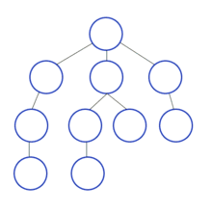
DFS: Depth-First Search
Visiting a vertex $v$, recursively visit (start DFS) each of its unvisited neighbors.
DFS(v)
Mark v as ‘visited’
For each u in Adj(v):
if u is unvisited:
DFS(u) https://en.wikipedia.org/wiki/Depth-first_search

Slide 10
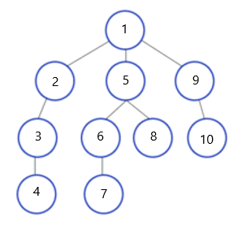
DFS: Depth-First Search
Visiting a vertex $v$, recursively visit (start DFS) each of its unvisited neighbors.
DFS(v)
Mark v as ‘visited’
For each u in Adj(v):
if u is unvisited:
DFS(u) https://en.wikipedia.org/wiki/Depth-first_search

Slide 11
DFS: Depth-First Search
For graph exploration, we often need to perform some processing before / after recursive DFS.
DFS(v)
PreVisit(v)
Mark v as ‘visited’
For each u in Adj(v):
if u is unvisited: DFS(u)
PostVisit(v)

Slide 12
DFS: explicit stack implimentation
Recursive implementation can lead to ‘stack overflow’ error ☹
=> An alternative implementation using explicit stack.

Slide 13
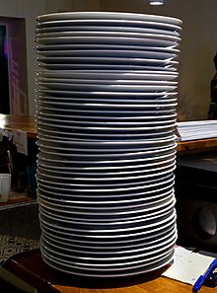
Stack: abstract data structure
Stack = abstract data structure with two principal operations:
Push(item)
Pop()
LIFO = Last-In, First-Out

Slide 14
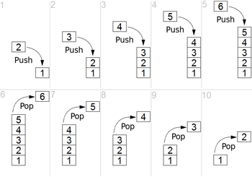
Stack: abstract data structure
Stack = abstract data structure with two principal operations:
Push(item)
Pop()
[Get the top item]
https://en.wikipedia.org/wiki/Stack_(abstract_data_type)

Slide 15
Stack: abstract data structure
https://people.cs.vt.edu/~shaffer/Book/

Slide 16
Stack: implementation
A stack data structure can be implemented in different ways:
array based
linked-list based

Slide 17
Stack: array-based implementation
template <typename E> class ads_stack_array: public Stack<E>
Version 1: STL array
{
protected:
std::vector<E> arr;
}
Version 2: static array
{
protected:
E* arr;
size_t top; // index of the top item
void resize();
}

Slide 18
Stack: dynamic list-based implementation
A dynamic list data structure with top (=head) pointer.
item
item
item
item
Top
New item

Slide 19
DFS: explicit stack implementation
StackDFS(G)
Select $s∈V$
Push(s)
While (stack is not empty):
v = Pop()
if v is unvisited:
Mark v as ‘visited’
For each u in Adj(v):
Push(v)

Slide 20
DFS: example

