Slide 1
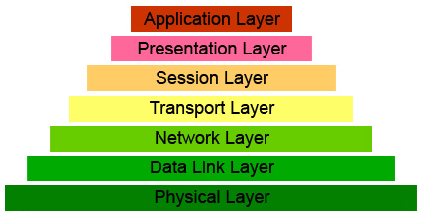
Network Layer

Slide 2
Main Components
Protocol IP – works on all computers in the transmission chain. At each stage, it decides who to send next (routing tables)
Routing protocols - provide dynamical change of routing tables
Hierarchical addressing system
(IP-addresses)

Slide 3
IP addresses
IP address - a 4-byte number (32 bits)
  For example, 192.168.10.153
It is assigned to each interface
An IP address is considered to consist of two parts:
  network part (subnet address)
  interface part (node interface address)

Slide 4
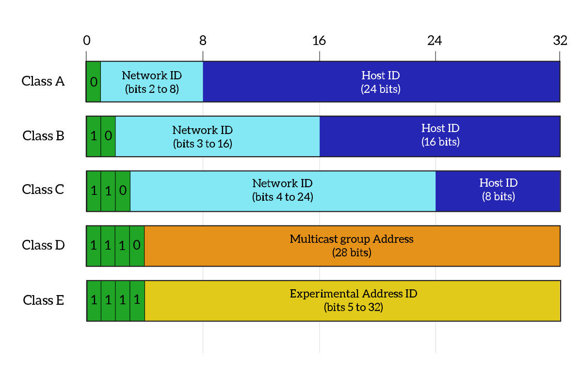
Outdated Network Classes

Slide 5
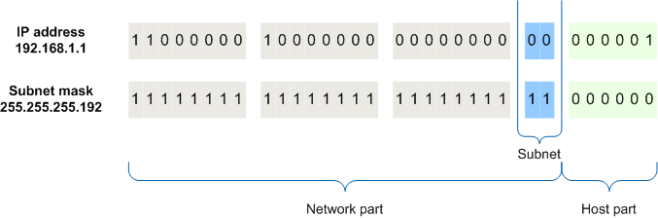
Classless Addressing

Slide 6
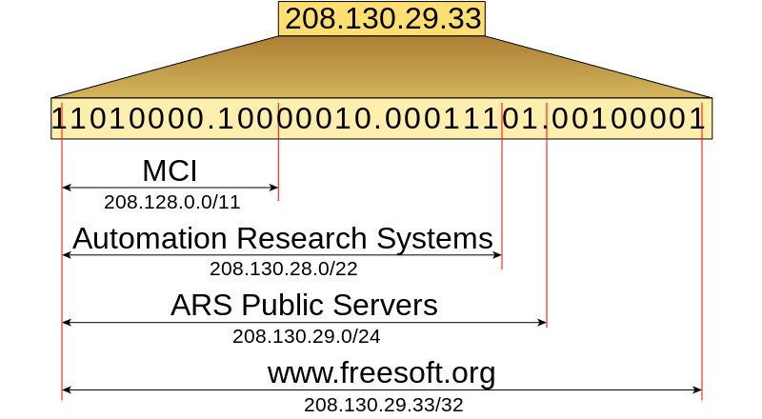
Hierarchy of IP-addresses

Slide 7
Reserved Addresses
255.255.255.255 – broadcast
127.0.0.0/8 – loopback (localhost)
10.0.0.0/8, 172.16.0.0/12, and
192.168.0.0/ 16 are private networks connected to the Internet via NAT

Slide 8
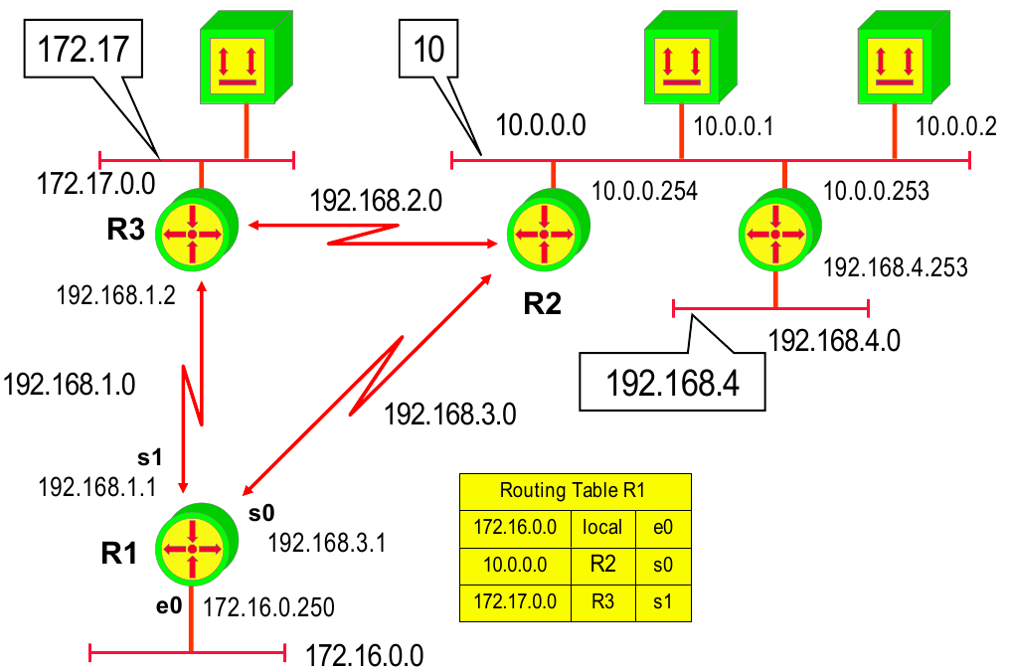
Principles of data transmission
by protocol IP

Slide 9
Real Routing Table
route print
Network Destination Netmask Gateway Interface Metric
0.0.0.0 0.0.0.0 195.208.237.1 195.208.237.244 10
0.0.0.0 0.0.0.0 25.0.0.1 25.88.172.250 9256
25.0.0.0 255.0.0.0 On-link 25.88.172.250 9256
25.88.172.250 255.255.255.255 On-link 25.88.172.250 9256
25.255.255.255 255.255.255.255 On-link 25.88.172.250 9256
127.0.0.0 255.0.0.0 On-link 127.0.0.1 306
127.0.0.1 255.255.255.255 On-link 127.0.0.1 306
127.255.255.255 255.255.255.255 On-link 127.0.0.1 306
192.168.56.0 255.255.255.0 On-link 192.168.56.1 276
192.168.56.1 255.255.255.255 On-link 192.168.56.1 276
192.168.56.255 255.255.255.255 On-link 192.168.56.1 276
195.208.237.0 255.255.255.0 On-link 195.208.237.244 266
195.208.237.244 255.255.255.255 On-link 195.208.237.244 266
195.208.237.255 255.255.255.255 On-link 195.208.237.244 266
224.0.0.0 240.0.0.0 On-link 127.0.0.1 306
224.0.0.0 240.0.0.0 On-link 192.168.56.1 276
224.0.0.0 240.0.0.0 On-link 195.208.237.244 266
224.0.0.0 240.0.0.0 On-link 25.88.172.250 9256
255.255.255.255 255.255.255.255 On-link 127.0.0.1 306
255.255.255.255 255.255.255.255 On-link 192.168.56.1 276
255.255.255.255 255.255.255.255 On-link 195.208.237.244 266
255.255.255.255 255.255.255.255 On-link 25.88.172.250 9256

Slide 10
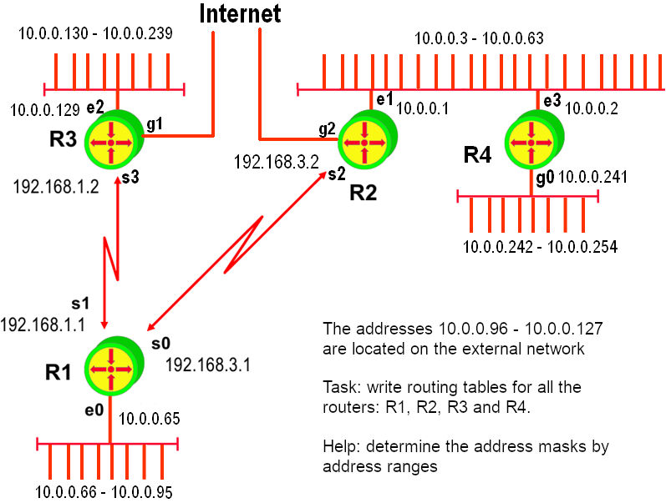
Homework

Slide 11
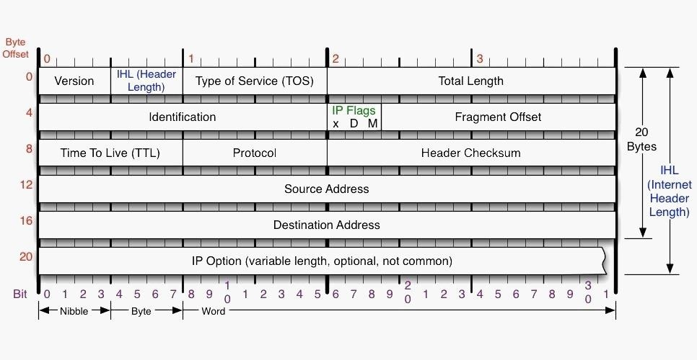
IP Header

Slide 12
Service Protocols. ICMP
ICMP - Internet Control Message Protocol
Transmitting error information in datagrams (main task)
Used in the program PING, which checks whether the remote computer is alive
Used in the program TRACEROUTE defining the route to the specified computer

Slide 13
Service protocols. DHCP
DHCP - dynamic host configuration protocol
Provides automatic IP address assign to computers
Three IP-address assign schemes:
  manual
  automatic
  dynamic

Slide 14
Operating principles of DHCP
The client computer sends a broadcast UDP-packet:
"Who can assign me IP "address"?
DHCP– servers send in response offers
The client receives a list of offers, selects the appropriate one, and sends DHCP request to a specific server
DHCP server sends a confirmation with specified IP address assigned to the client.

Slide 15
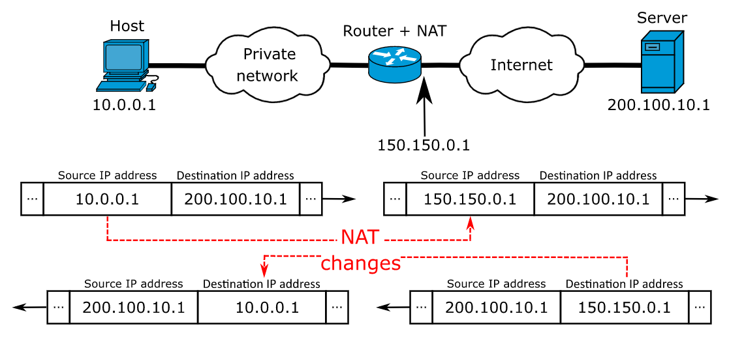
Solving the problem of
IP-addresses shortfall (NAT)

Slide 16
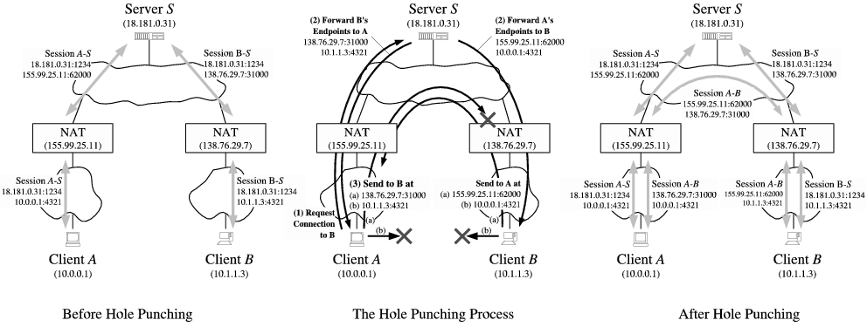
Hole punching NAT
Notes:
http://www.brynosaurus.com/pub/net/p2pnat/

Slide 17
Routing
Routing — the process of determining the route of a packet in the network. It is defined by the hosts routing tables
Routing types:
  static
  dynamic
Routing algorithms:
  distant-vector
  link state

Slide 18
Hierarchical Routing
The entire network is divided into nested subnets
Internal routing protocols are used within each autonomous subnet
Autonomous subnets connect to each other using gateways
Routing between these gateways is external routing
All together, it can also be a standalone subnet
Protocols:
  internal: RIP (Routing Information Protocol) и
  OSPF (Open Shortest Path First)
  external: BGP (Border Gateway Protocol)

Slide 19
RIP:
Routing Information Protocol
Initial Table A
Dest | Cost | Next Hop
A | 0 | A
B | 4 | B
C | ∞ | –
D | ∞ | –
E | 2 | E
F | 6 | F
E
C
3
1
F
1
2
6
1
3
D
A
4
B
Idea
  Each node stores a distance vector containing distances to subnets and directions
  If the network is unavailable, assign ∞ to the distance
In the beginning, nodes only know their neighbors

Slide 20
Distance Vectors Update
z
d(z,y)
c(x,z)
y
x
d(x,y)
Update(x,y,z)
d := c(x,z) + d(z,y) # Distance from x to y through z
if d < d(x,y)
# we find the better one
return d, z # distance and direction
else
return d(x,y), next_hop(x,y) # old is better

Slide 21
Bellman-Ford Algorithm
Cycle
For each node x
For each node z
For each direction y
d(x,y) := Update(x,y,z)
Until the distances stop changing

Slide 22
Initial Vectors
(Routing tables)
Table for A
Dst | Cst | Hop
A | 0 | A
B | 4 | B
C | ∞ | –
D | ∞ | –
E | 2 | E
F | 6 | F
Table for B
Dst | Cst | Hop
A | 4 | A
B | 0 | B
C | ∞ | –
D | 3 | D
E | ∞ | –
F | 1 | F
E
C
3
1
F
1
2
6
1
3
D
A
4
B
Table for C
Dst | Cst | Hop
A | ∞ | –
B | ∞ | –
C | 0 | C
D | 1 | D
E | ∞ | –
F | 1 | F
Table for D
Dst | Cst | Hop
A | ∞ | –
B | 3 | B
C | 1 | C
D | 0 | D
E | ∞ | –
F | ∞ | –
Table for E
Dst | Cst | Hop
A | 2 | A
B | ∞ | –
C | ∞ | –
D | ∞ | –
E | 0 | E
F | 3 | F
Table for F
Dst | Cst | Hop
A | 6 | A
B | 1 | B
C | 1 | C
D | ∞ | –
E | 3 | E
F | 0 | F
Lecture 10: 2-10-2005

Slide 23
Iteration No.1
Table for A
Dst | Cst | Hop
A | 0 | A
B | 4 | B
C | 7 | F
D | 7 | B
E | 2 | E
F | 5 | E
Table for B
Dst | Cst | Hop
A | 4 | A
B | 0 | B
C | 2 | F
D | 3 | D
E | 4 | F
F | 1 | F
E
C
3
1
F
1
2
6
1
3
D
A
4
B
Table for C
Dst | Cst | Hop
A | 7 | F
B | 2 | F
C | 0 | C
D | 1 | D
E | 4 | F
F | 1 | F
Table for D
Dst | Cst | Hop
A | 7 | B
B | 3 | B
C | 1 | C
D | 0 | D
E | ∞ | –
F | 2 | C
Table for E
Dst | Cst | Hop
A | 2 | A
B | 4 | F
C | 4 | F
D | ∞ | –
E | 0 | E
F | 3 | F
Table for F
Dst | Cst | Hop
A | 5 | B
B | 1 | B
C | 1 | C
D | 2 | C
E | 3 | E
F | 0 | F
Lecture 10: 2-10-2005

Slide 24
Iteration No.2
Table for A
Dst | Cst | Hop
A | 0 | A
B | 4 | B
C | 6 | E
D | 7 | B
E | 2 | E
F | 5 | E
Table for B
Dst | Cst | Hop
A | 4 | A
B | 0 | B
C | 2 | F
D | 3 | D
E | 4 | F
F | 1 | F
E
C
3
1
F
1
2
6
1
3
D
A
4
B
Table for C
Dst | Cst | Hop
A | 6 | F
B | 2 | F
C | 0 | C
D | 1 | D
E | 4 | F
F | 1 | F
Table for D
Dst | Cst | Hop
A | 7 | B
B | 3 | B
C | 1 | C
D | 0 | D
E | 5 | C
F | 2 | C
Table for E
Dst | Cst | Hop
A | 2 | A
B | 4 | F
C | 4 | F
D | 5 | F
E | 0 | E
F | 3 | F
Table for F
Dst | Cst | Hop
A | 5 | B
B | 1 | B
C | 1 | C
D | 2 | C
E | 3 | E
F | 0 | F
Lecture 10: 2-10-2005

Slide 25
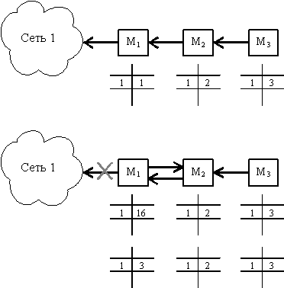
Unstable Operation when the Network Changes

Slide 26
OSPF: Link State Algorithm
At the beginning of work, as well as when a neighbor turn on/turns off, the node sends everyone its new adjacency list
Each node periodically checks the health of its neighbors
Each node stores a copy of the network graph
Each node computes a tree of shortest paths on the graph
  Dijkstra's algorithm is used

Slide 27
Dijkstra's algorithm
Given:
  Graph with a source s and edge weights c(u,v)
Task:
  calculate the shortest path from s to each node v

Slide 28
Dijkstra's algorithm
E
C
∞
2
3
5
1
Length of paths on
current iteration
F
2
2
6
A source s
0
1
∞
3
3
D
A
3
B
done
we haven't reached it yet
Node sets
  "done"
    The shortest paths to them have already been found
  "viewing"
    neighbors of nodes from "done"
  "we haven't reached it yet":
    the others
viewing
Node labels
for already viewed vetices
d(v) = length of the shortest path from the source s to v
for the currently viewed vertices
d(v) = min( d(neighbor) + weight of the edge from the neighbor), where neighbors are taken from "done"

Slide 29
Dijkstra's algorithm:
the beginning
E
C
∞
∞
3
∞
1
F
2
Length of paths on
current iteration
2
6
A source s
0
1
∞
∞
3
D
A
3
viewing
B
done
we haven't reached it yet

Slide 30
Dijkstra's algorithm:
the beginning
E
C
∞
2
3
6
1
F
2
2
6
A source s
0
1
∞
3
3
D
A
3
B
done
viewing
we haven't reached it yet
Calculate the d(v) for v from the viewing set,
Assign infinity to the rest

Slide 31
Dijkstra's algorithm:
one step
E
C
∞
2
3
6→5
1
F
2
2
6
A source s
1
0
D
∞
A
3
3
3
B
done
we haven't reached it yet
viewing
Find the vertice with the minimum d(v) in the set of viewing vertices
Add this node to the "done" set. Add the minimum edge to this vertice to the shortest path tree
Update the set of "viewing" vertices and recalculate it’s d(v)

Slide 32
Dijkstra's algorithm:
repeat
E
viewing
C
∞
2
3
5
1
F
2
2
6
A source s
0
1
∞
3
3
D
A
3
B
we haven't reached it yet
done

Slide 33
Dijkstra's algorithm
we haven't reached it yet
E
C
∞
2
3
4
1
F
2
2
6
A source s
0
1
6
3
3
D
A
3
B
viewing
done

Slide 34
Dijkstra's algorithm
E
C
5
2
3
4
1
F
2
2
6
A source s
0
1
6
3
3
D
A
3
B
The shortest path tree is marked in green

Slide 35
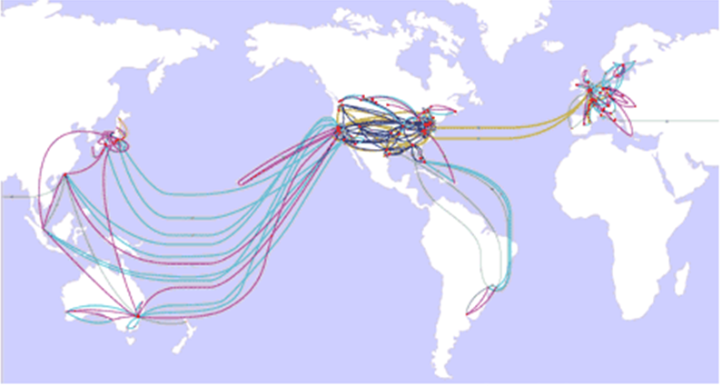
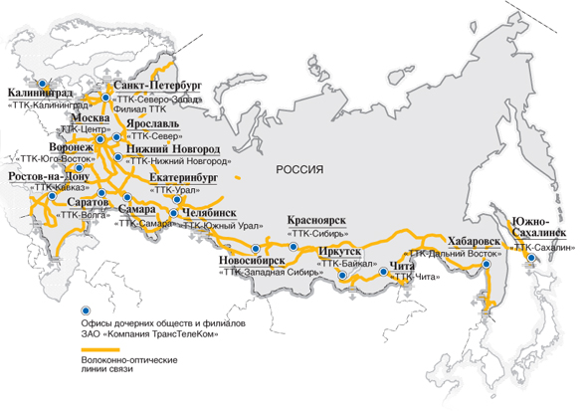
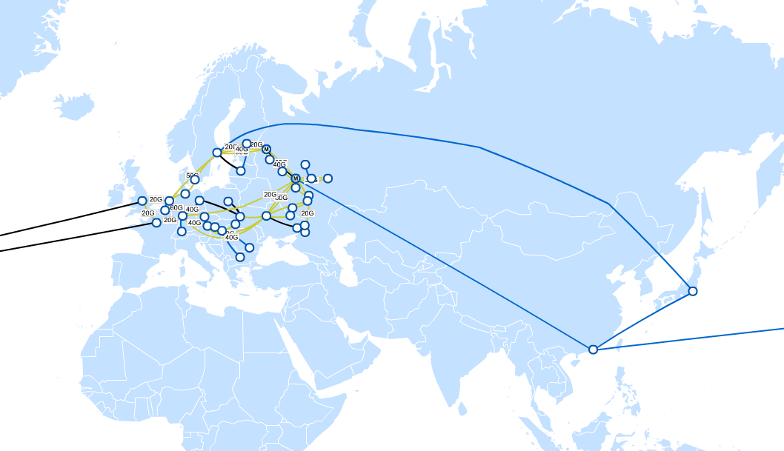
BGP:
external routing
Backbone providers
  Verison
  Retn.net
  TransTeleCom
  Golden telecom
  …..

Slide 36
BGP:
external routing
ISP
ISP
ISP
client
ISP provide communication services
only to it’s customers
ISP usually prohibit transit traffic
through it’s own networks
allowed
not
allowed

Slide 37
BGP:
external routing
ISP
ISP
ISP
client
P3
P1
P2
P4
P5
K1
K2
K3
K4

Slide 38
BGP:
autonomous systems (AS)
Autonomous system – a set of connected networks that use a single routing system
Numbers are assigned to autonomous systems by local Internet Registrars (LIR) usually at the same time as the block of IP-addresses is issued
Example:
  ASN Of Yandex = 13238
  ASN JSC Vimpel-Communications = 8402 (Corbina)

Slide 39

Graph of AS – is a Factor Graph of the Internet

Slide 40
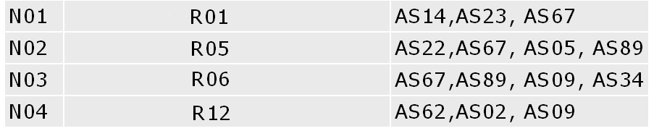
BGP:
External Routing
Routing table of BGP
Network
Next router
Path

Slide 41
Homework
Download and view it BGP-route table for MSK-IX http://www.msk-ix.ru/download/lg/msk_ipv4.txt.gz
You can find information about the autonomous systems of Russian and European providers here http://www.db.ripe.net/whois
List of rooms AS, connected to MSK-IX can be found here: http://www.msk-ix.ru/members/

Slide 42
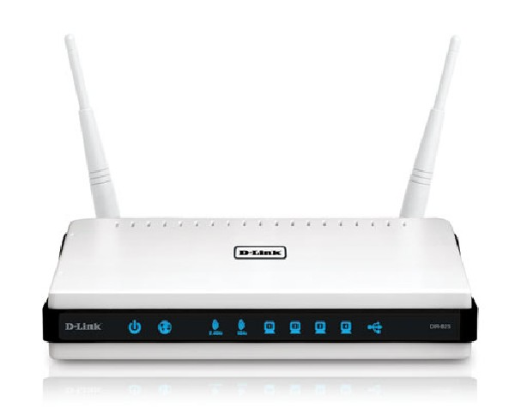
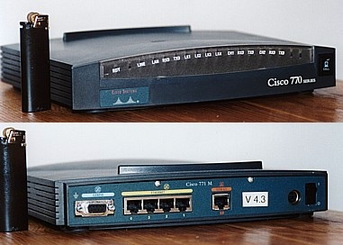
Routers

Slide 43
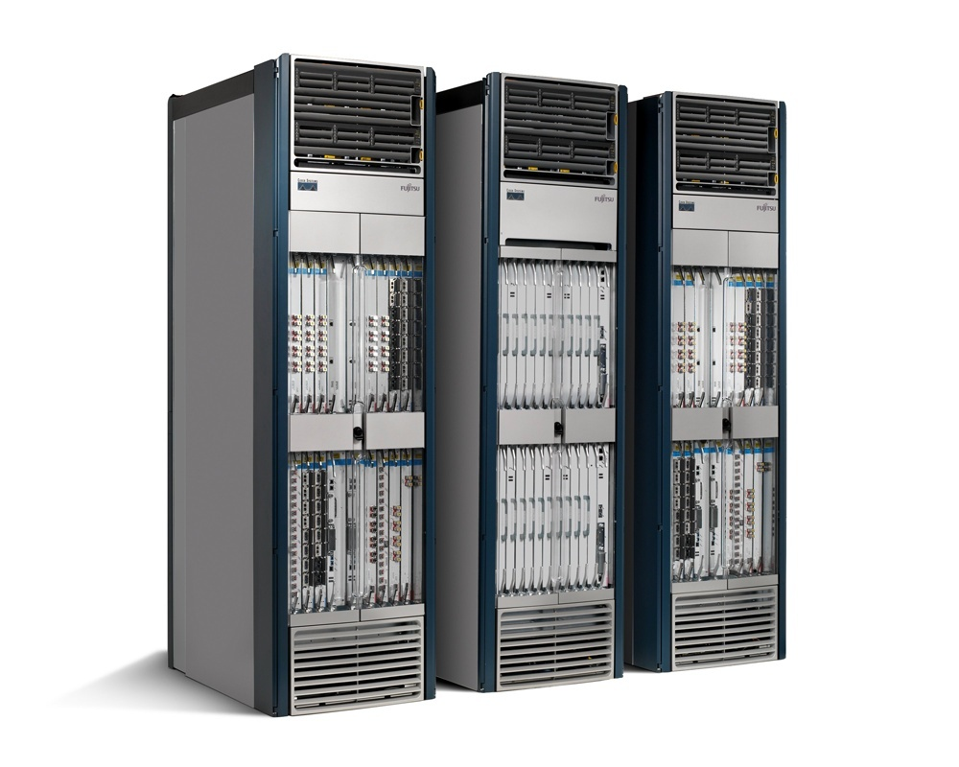
Routers

Slide 44
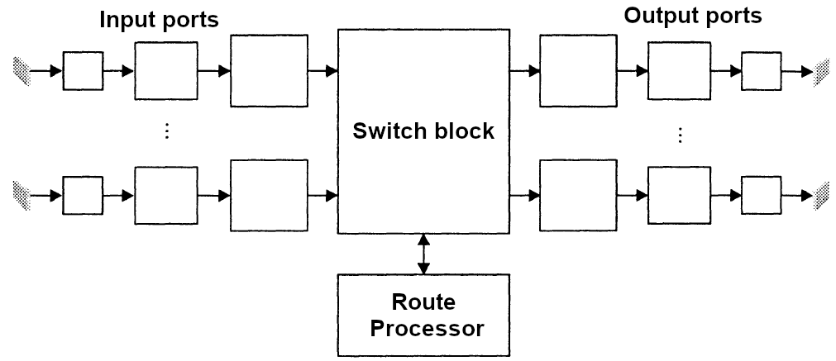
Router Inside
The main task of a router is to receive a datagram and send it over one of its network interfaces

Slide 45
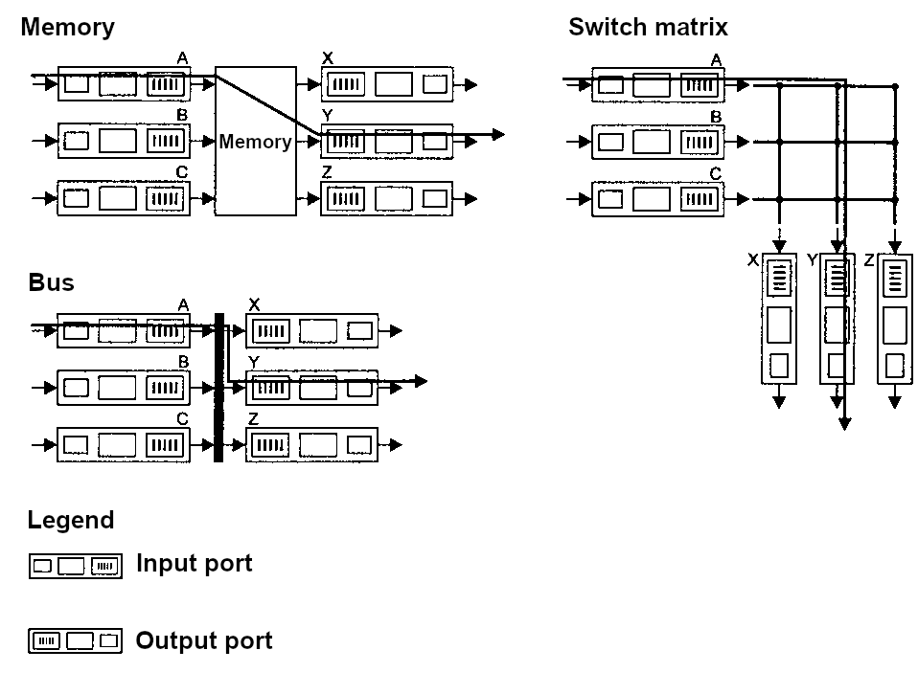
Switching methods

Slide 46
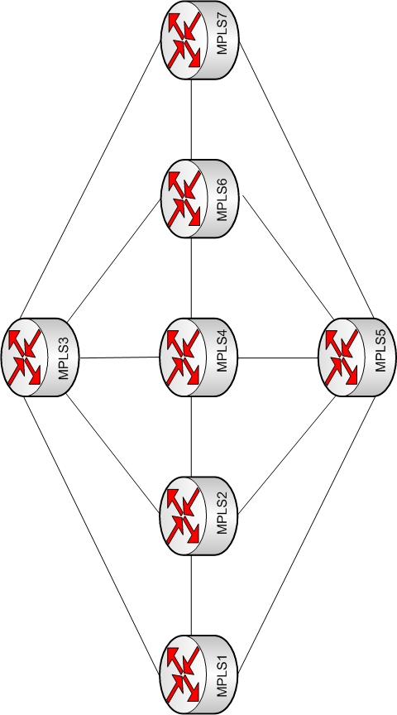
Multiprotocol Label Switching
(MPLS)

Slide 47
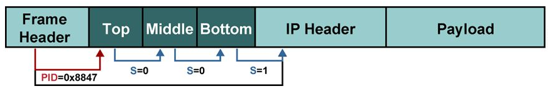
Review MPLS
Used to speed up packet routing (RFC 3031)
Idea: use a 20-bit label instead of a variable-length network number
  The placemark is placed in the header MPLS between link-layer and network-layer headers
Supports all network and data link layer protocols

Slide 48
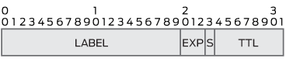
MPLS Header Format
20-bit label
EXP:QoS field, describing the service class of the package
S: end indicator of multiple MPLS-headers
TTL: Time to Live

Slide 49
MPLS Routing
The input LSR (Label switching router) of the MPLS domain assigns labels to packets that define their further path in the network
Internal LSRs:
  use the label to identify the next router
  send the packet to the next LSR (they can change the label)
The output LSR removes MPLS header and routes the packet based on the IP address

Slide 50
Forwarding Equivalence Class
The input router assigns labels based on Forwarding Equivalence Classes (FEC)
The package class can be defined as:
  IP-source/destination addresses
  source/destination ports
  by protocol
  DSCP - Differentiated services code point
  using the input interface

Slide 51
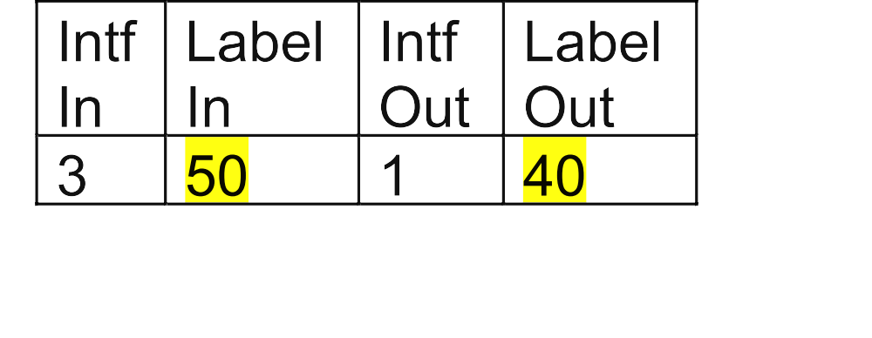
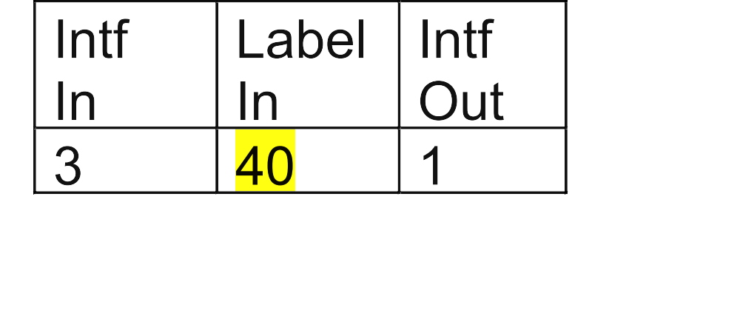
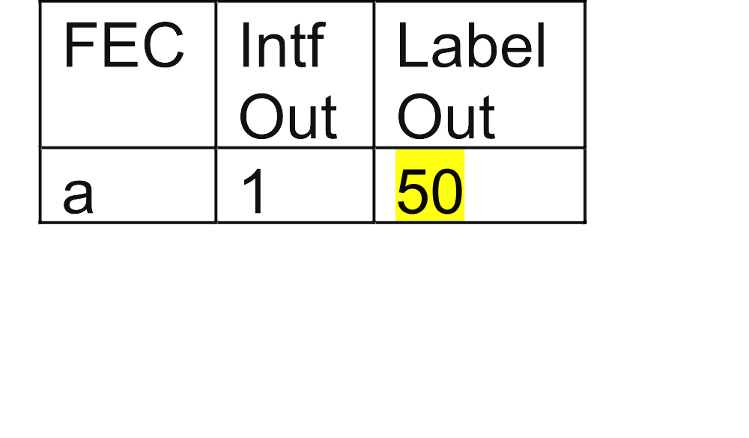
Example
1
3
3
1
40
2
1
2
3
50
2

Slide 52

IPv6 protocol

Slide 53
IPv6 Protocol
IPv4 → IPv6
Address – 16 bytes
Reasons for switching to Ipv6
  insufficient 32-bit address space
  overgrowth of routing tables
  complexity of mass IP address changes
  relative complexity of processing IPv4 packet headers

Slide 54
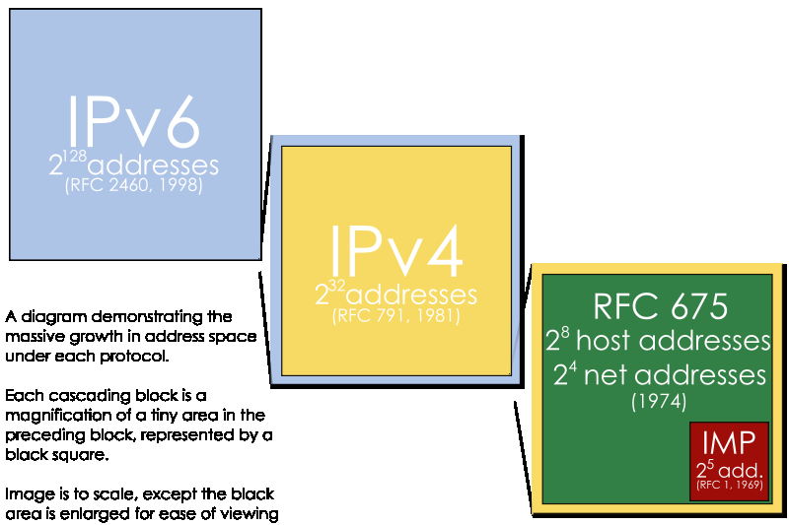
Address Space Growth

Slide 55
IPv6: Addresses
They are written as 8 two-byte numbers:
  2001:0db8:0049:0000:ab00:0000:0000:0102
Record abbreviations:
  2001:0db8:0000:0000:0000:0000:1428:57ab
  2001:0db8:0000:0000:0000::1428:57ab
  2001:0db8:0:0:0:0:1428:57ab
  2001:0db8:0:0::1428:57ab
  2001:0db8::1428:57ab
  2001:db8::1428:57ab

Slide 56
IPv6: Address Types
Types:
  unicast
  anycast
  multicast
Reserved addresses
  :: ↔ 0.0.0.0
  ::1 ↔ 127.0.0.1
  2002:ab:cd::/16 ↔ a.b.c.d (6to4 addresses)
  FF**:: - broadcast

Slide 57
IPv6: Stream Labels
A stream is a sequence of packets sent by a sender to a specific destination
Stream labels are random 24-bit numbers
The transmission direction is calculated only for the first packet and stored in the cache
All other packets with the same label from the same sender are sent to the same destination.

Slide 58
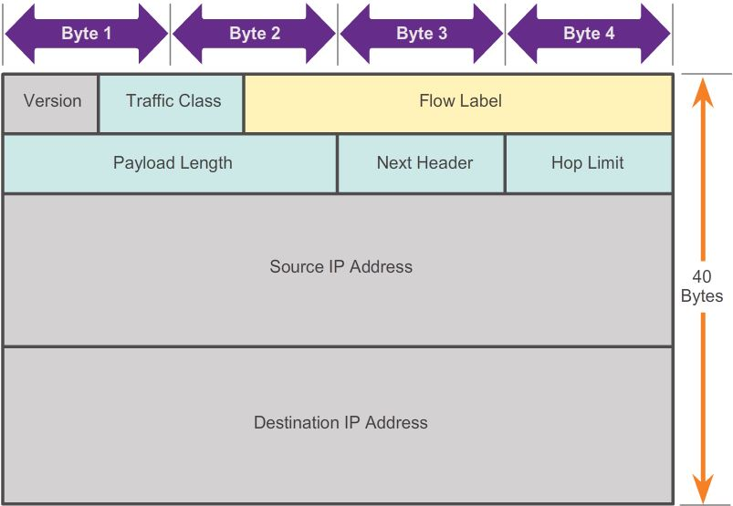
IPv6 Header

Slide 59
Switching from IPv4 on IPv6
Interaction of IPv6 and IPv4
  solutions:
    tunneling (6to4, Teredo)
    double stack
    translation
Incompatibility with DNS
  decision:
    creating the record type AAAA
    creating the domain ip6.arpa

Slide 60
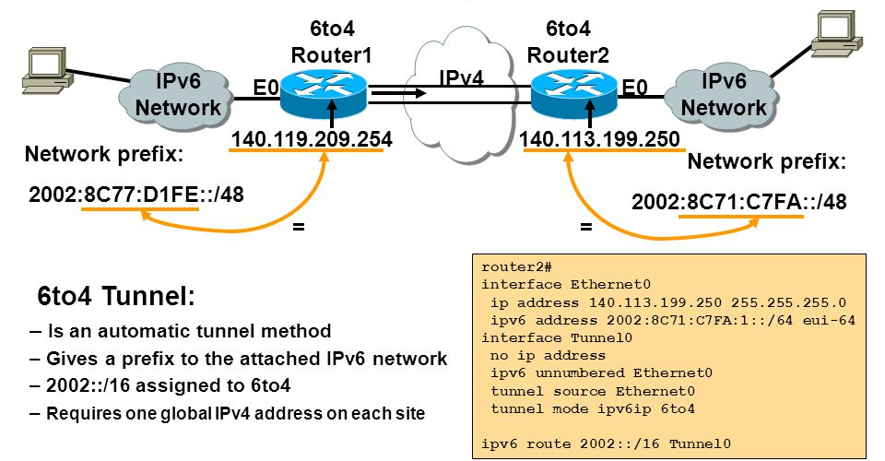
6to4 Tunnel

Slide 61
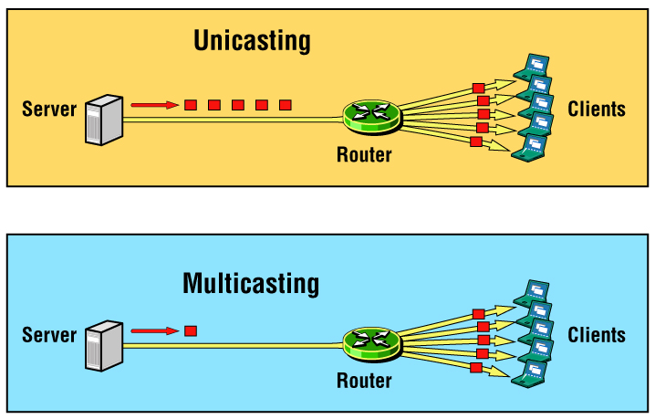
Multicasting

Slide 62
Applications
TV and radio broadcasting
Software Distribution
Multi-participant video conferences
Multiplayer games

Slide 63
Multicast Architecture
Group addresses
Hosts
Hosts and routers
interactions
protocol
(IGMP)
Routers
Multicast routing protocols

Slide 64
Multicast Architecture (RFC1112)
Each group has one IP-address
The number of computers in a group is unlimited
Group members can be located anywhere
Hosts can join or leave the group whenever they want
Data flow sources may not be the members of the group
Only the host and routers know that the host belongs to a group
An analogy:
  Each multicast address is like a radio frequency that anyone can listen to

Slide 65
Group addresses
IP-class addresses D
  224.0.0.0 – 239.255.255.255
The assignment of multicast IP adresses:
  Well-known ones - by an organization IANA
  The rest are assigned dynamically
1
1
1
0
ID groups

Slide 66
Multicast API
Sending – normal (port, sendto)
Receiving – two new features
  Join Group
  Leave Group
Receiving by recvfrom function
Programming: you need to set the option for the socket
setsockopt(… IP_ADD_MEMBERSHIP …)

Slide 67
IGMP - Internet Group Management Protocol
Protocol for interaction between clients and routers
Each client remembers all the groups it belongs to - functions of Socket API notify the IGMP service about groups
Task: keep routers' group information up-to-date

Slide 68
IGMP: Joining a Group
IGMP Membership-Report
Example : R joins
to a group 224.2.0.1
R sends IGMP Membership-Report by address 224.2.0.1
DR receives and will then forward the group's packets 224.2.0.1 to network A
DR sends it out periodically IGMP Membership-Query to group address 224.0.0.1
R notifies, that it is subscribed to 224.2.0.1
R
Network A
DR
Network B
Data for 224.2.0.1
R - receiver
DR – a dedicated router

Slide 69
IGMP: Exit the Group
IGMP Leave-Group
Example : R leaves the group 224.2.0.1
R sends IGMP Leave-Group to 224.2.0.1
DR gets it
If there are no more 224.2.0.1 group members in Network A then DR stops sending packets there
R
Network A
DR
Network B
Data for 224.2.0.1
R - receiver
DR – a dedicated router

Slide 70
How IGMP operates
Routers:
Q
Clients:
Among the routers connected to the same hosts, select one that will poll all the cients
The selected router periodically sends a Membership Query for all the groups, with TTL = 1
To prevent the reply storm each host wait for a random time and send reply (if no one sent before him)

Slide 71
Group broadcast zone control – small TTL
s
1
2
3

Slide 72
Multicast Traffic Routing
The goal is to build a tree of data distribution from the source to all recipients
Flood-and-prune
  We start sending traffic to all computers on the network
  Then block sending to subnets where there are no recipients
  Protocols: DVMRP, PIM-DM
Routing protocols based on link state
  Routers tell everyone groups that have recipients
  If necessary, calculate the tree of shortest paths to recipients
  Data is transmitted to the network, if only someone from this network has notified routers about their participation in the group
  Example: MOSPF, PIM-SM
Notes:
http://www.cse.wustl.edu/~jain/cis788-97/ftp/ip_multicast/index.htm#Multicast-Routing-Protocols

Slide 73
Implementation Difficulties
It is mainly used in local/regional networks
Difficulties:
  Scalability of routing protocols
  Complex administration
  Hard to implement broadcast TCP
  There are few apps that support broadcasting
  Routers may not support broadcasting
  Providers block broadcast traffic

